Slide 1
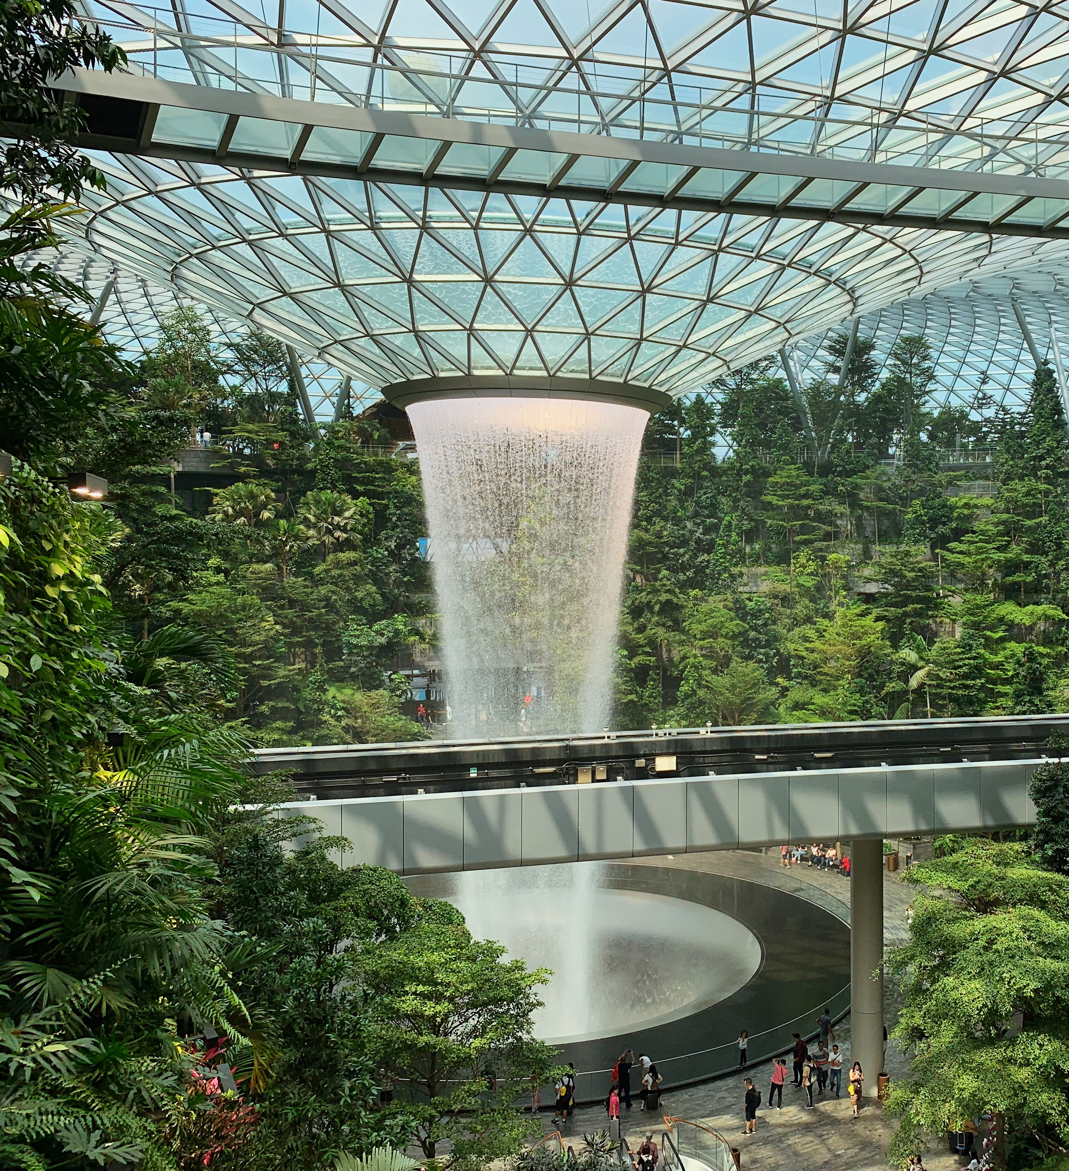
Data Analysis of Indonesian Visitors
Clarence San

Slide 2
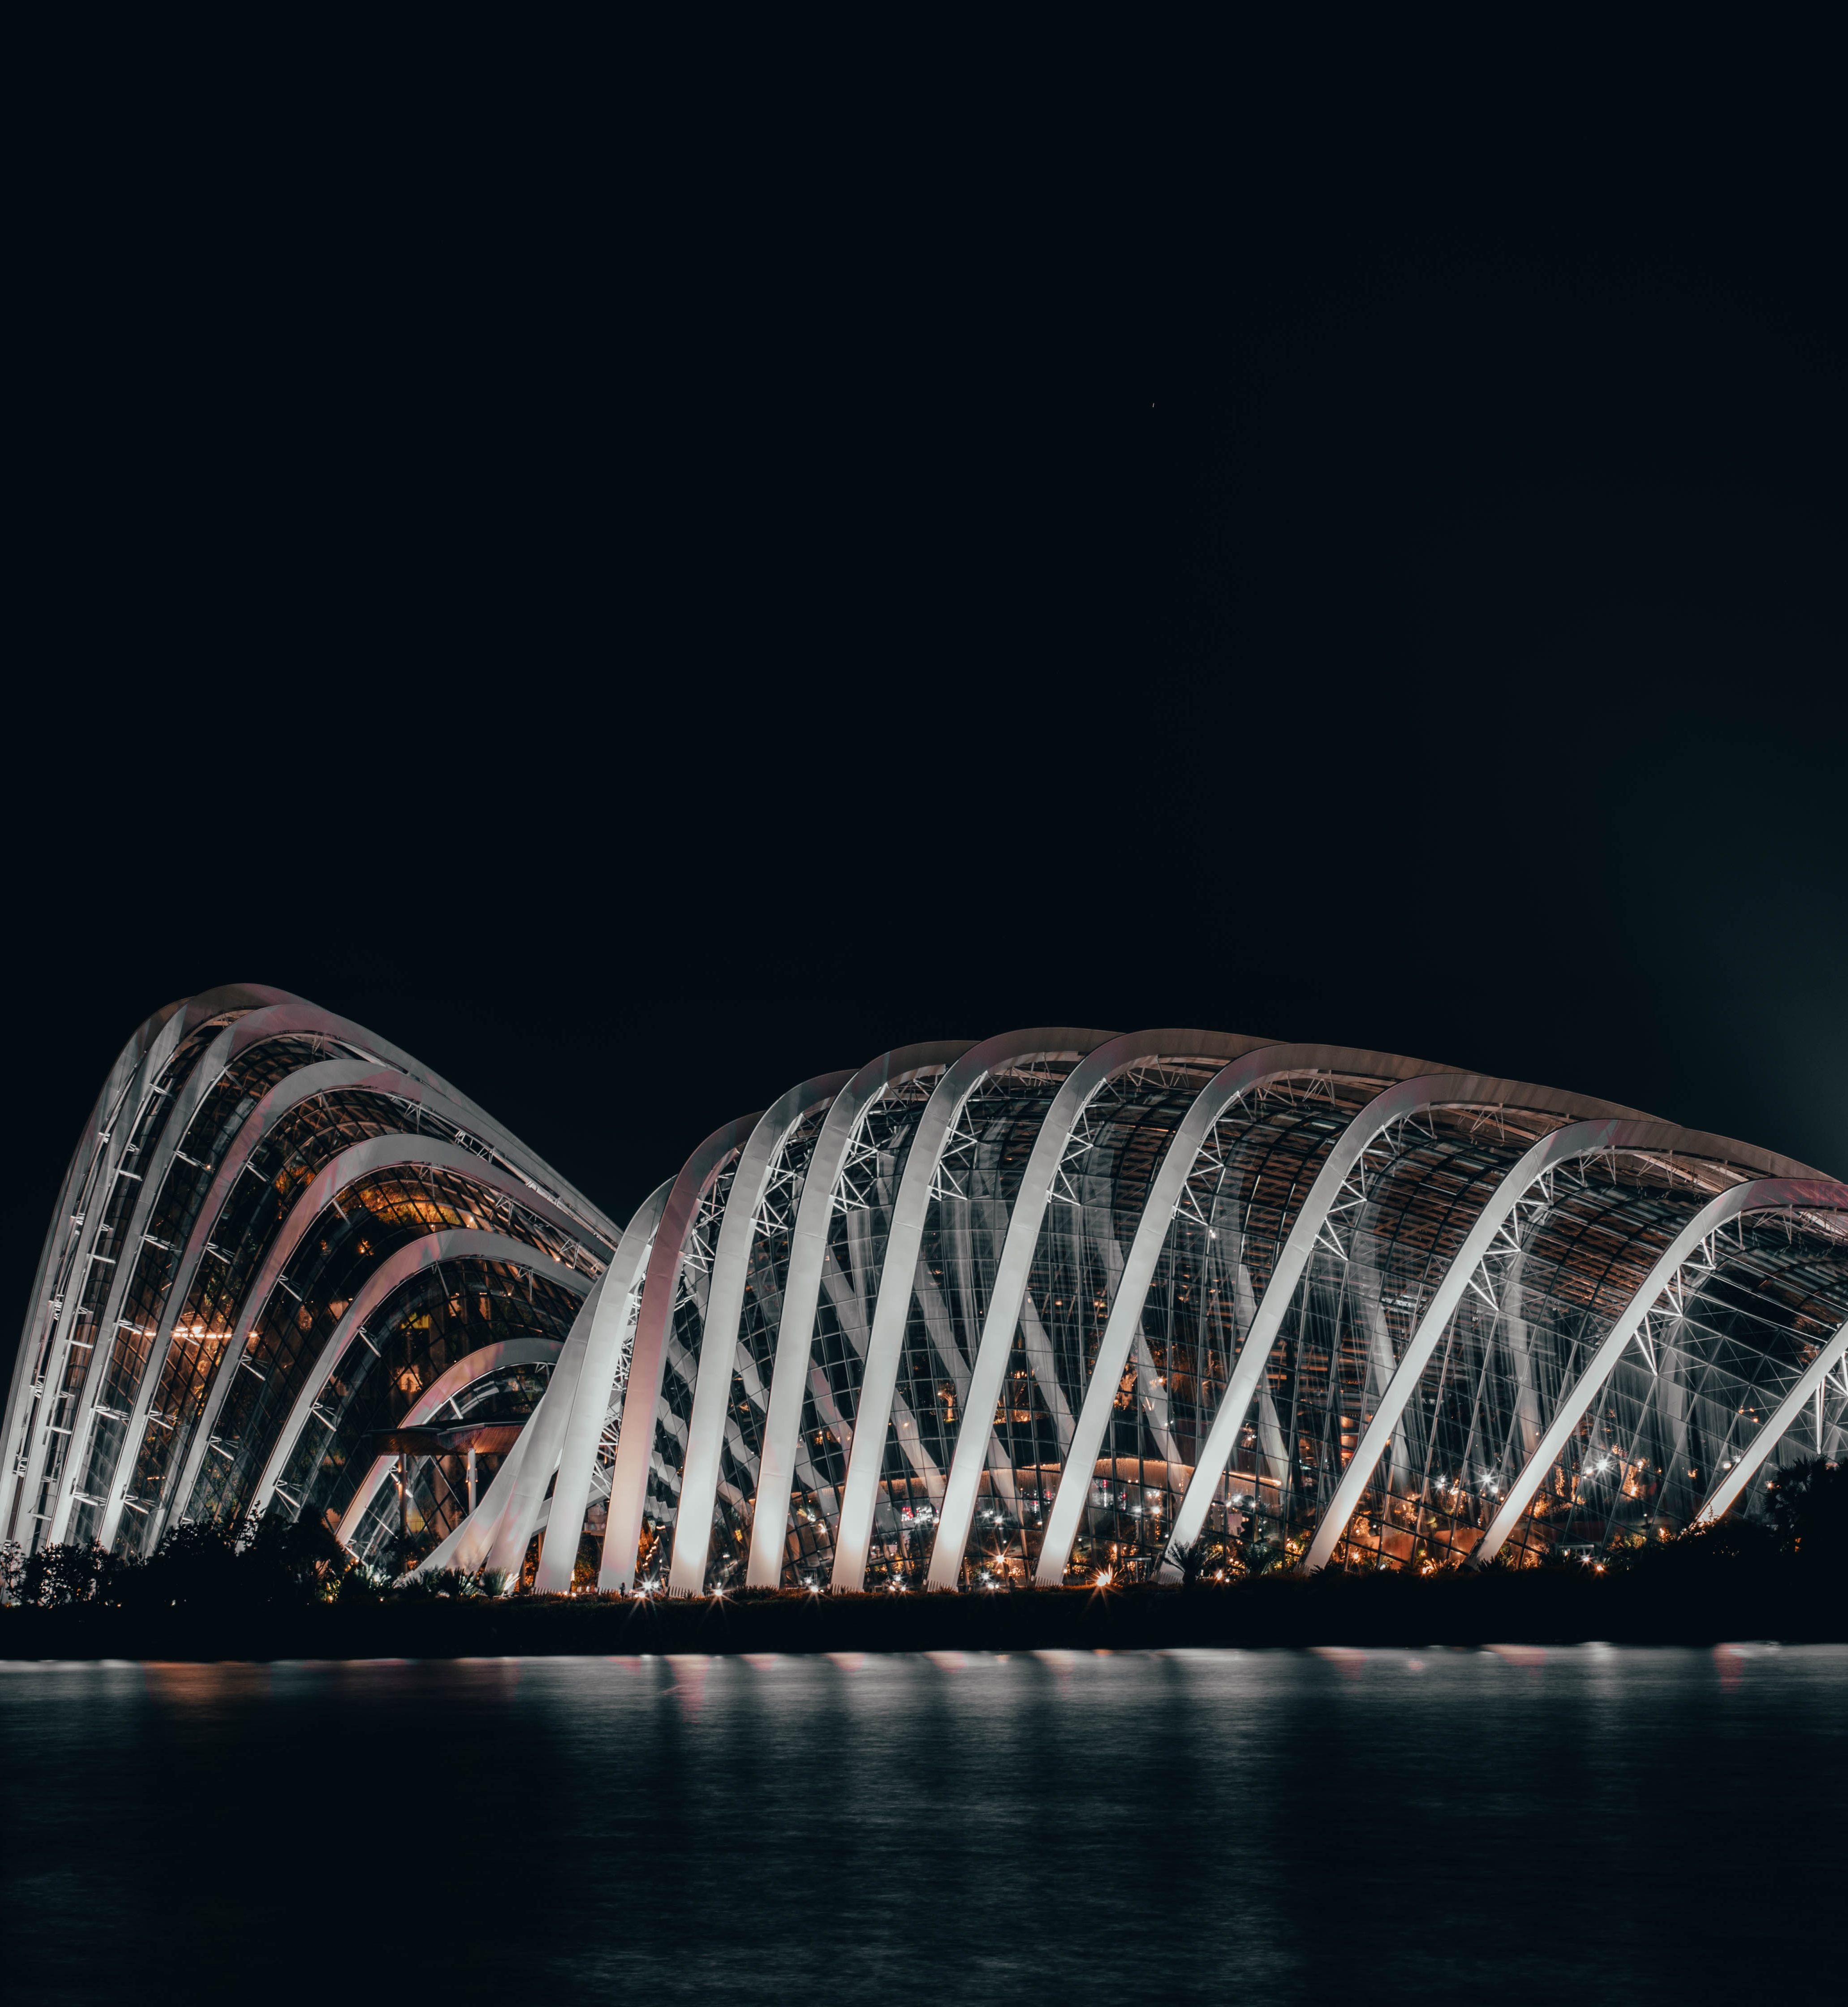
Background and Context
The dataset analysed contains historical records of Indonesian visitors in a year.
This presentation covers key insights and trends amongst Indonesian visitors to Singapore^{1, 2}.
32
1
6
Variables
ID Variable
Spend-related
Variables
16
2952
Variables on Visitor Info
Records

Slide 3
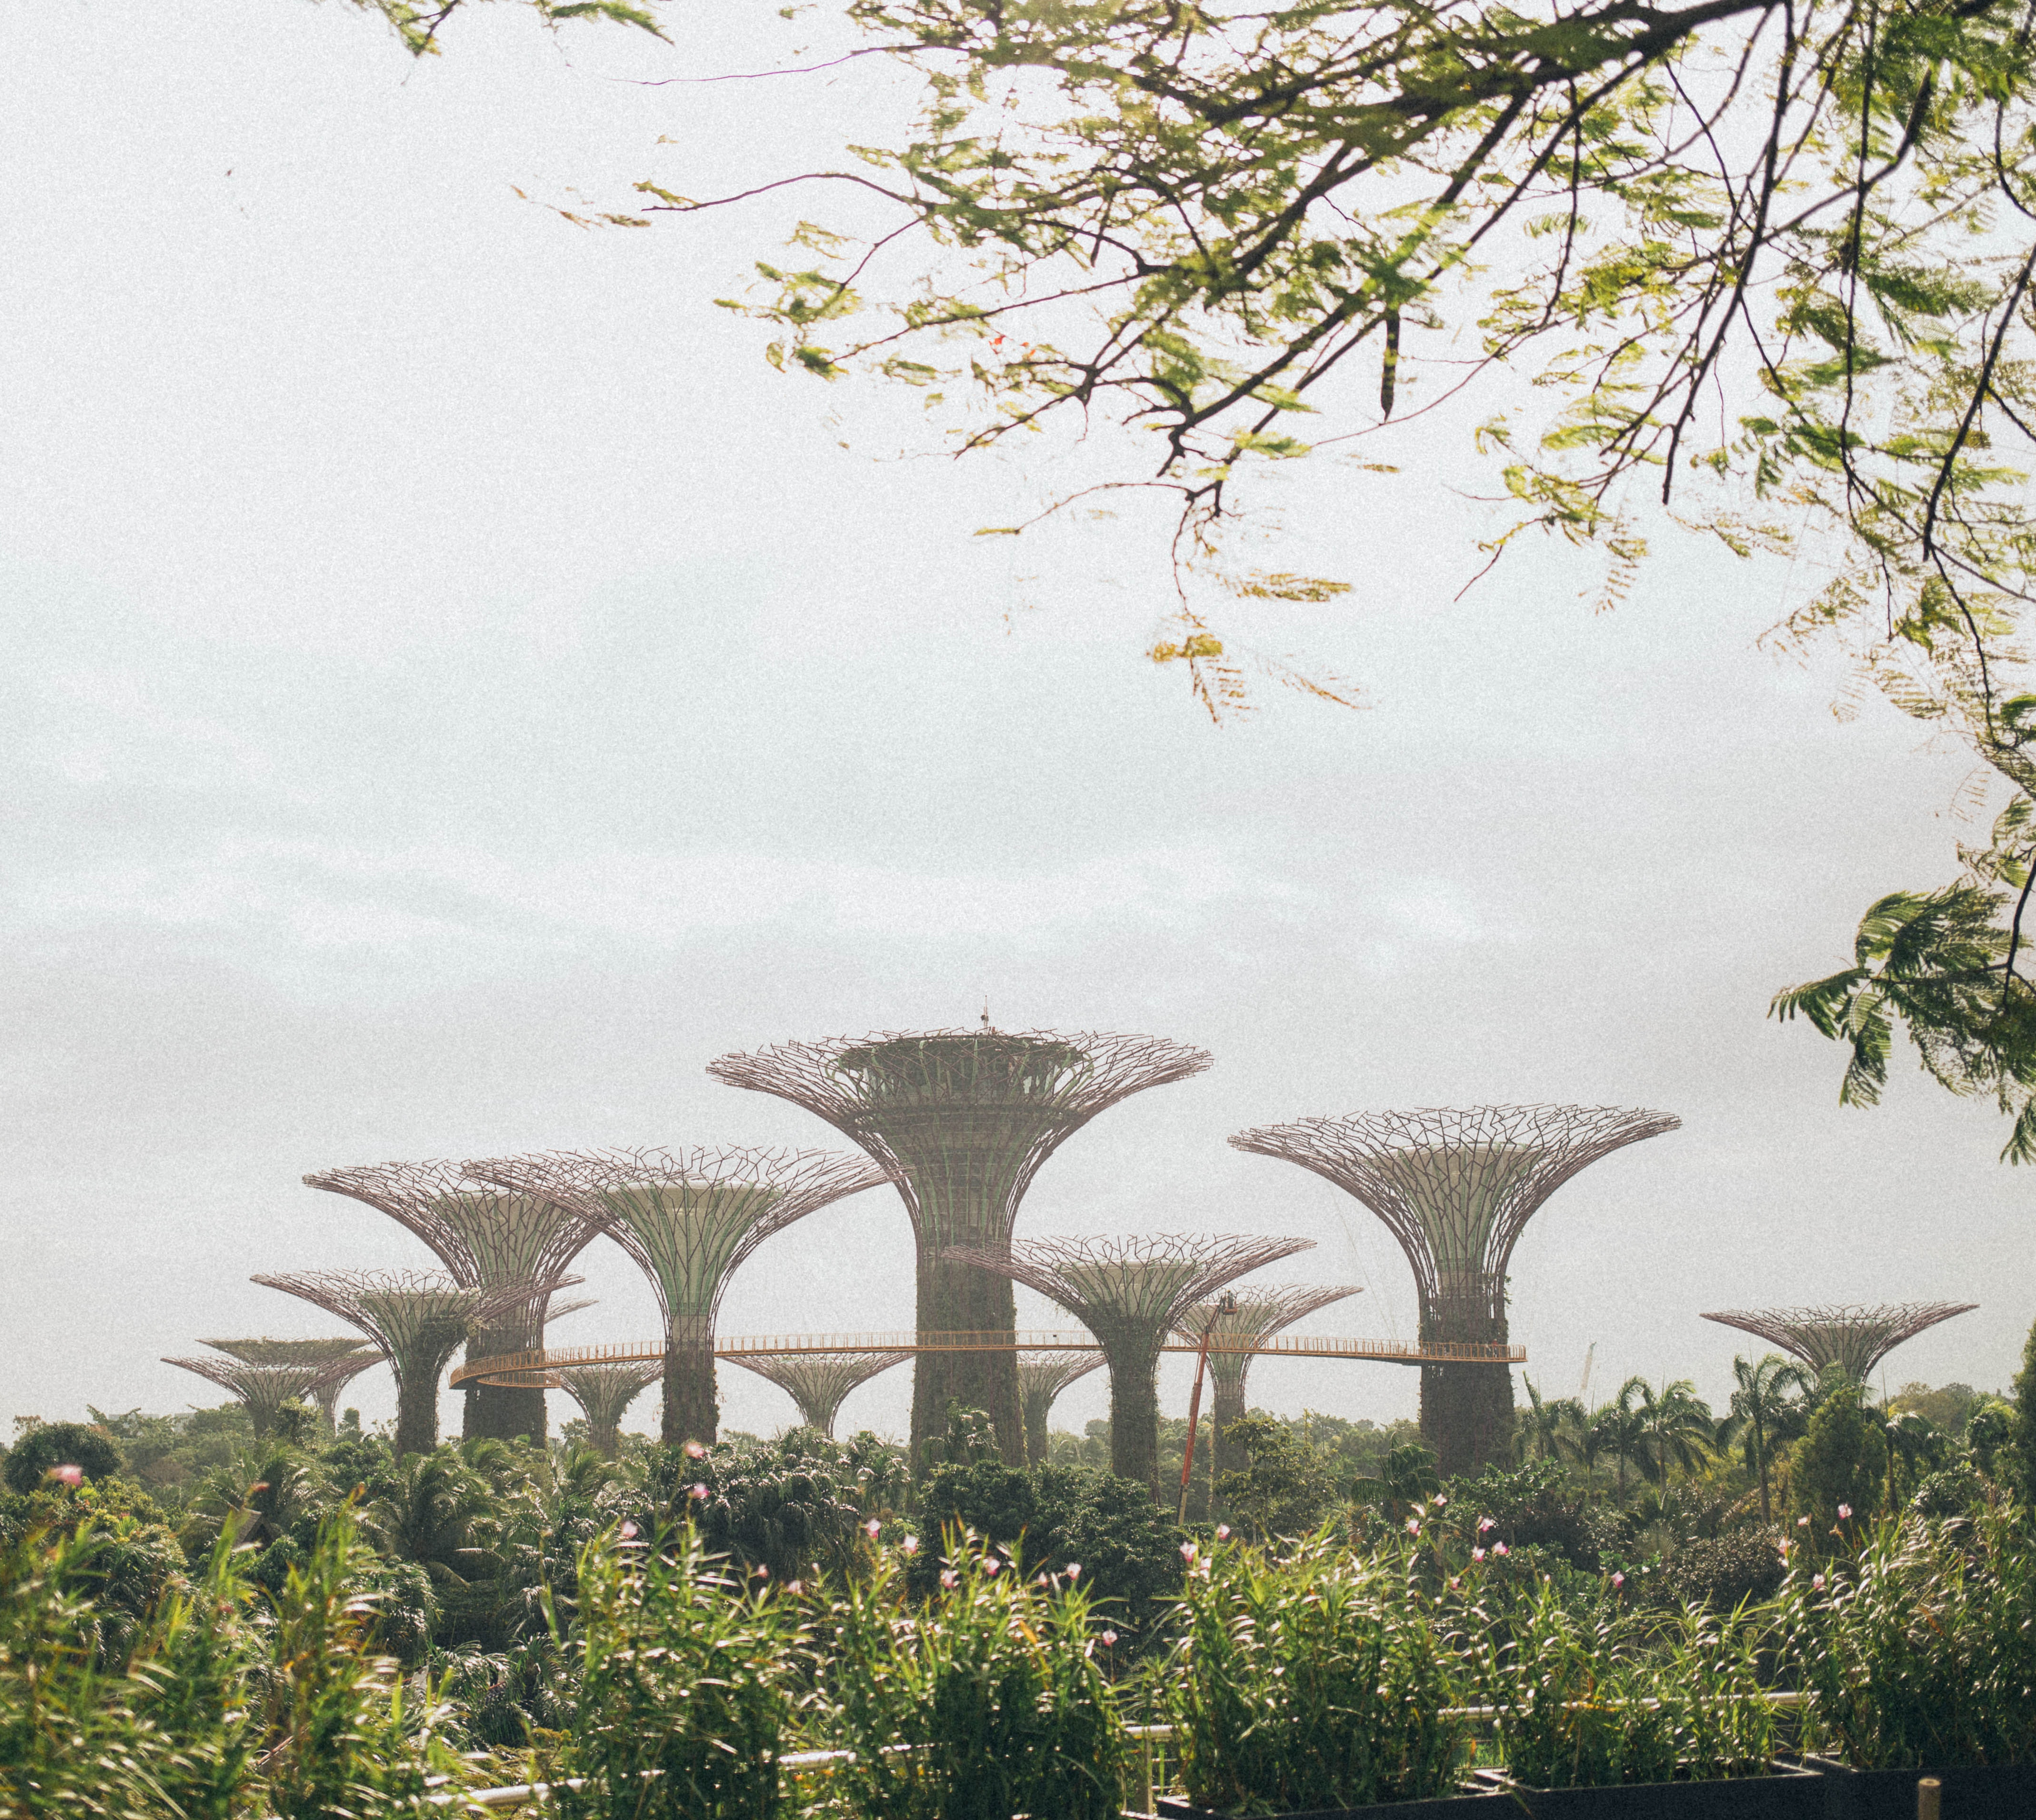
EDA
Coverage
Plotting distributions of numerical variables
Plotting counts of categorical variables
Who are our visitors and how can we describe them?

Slide 4
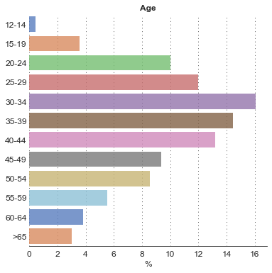
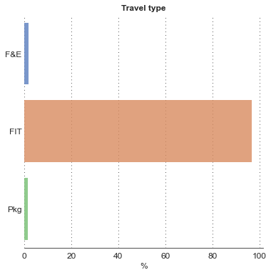
Most of our visitors in the year are aged 25-49 and not attached to any tour group.
96% of visitors are FIT travellers – these individuals are not on any sort of tour package and are in charge of planning their own itineraries.
Prompt: How can we make information more accessible to aid the planning for this group?
Charts
Breakdown of visitors by age, reported in percentages
Breakdown of visitors by travel type¹, reported in percentages

Slide 5
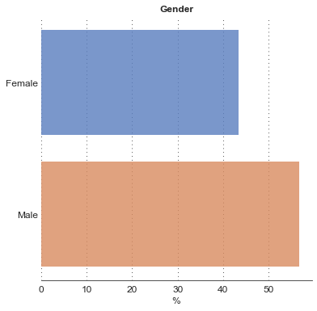
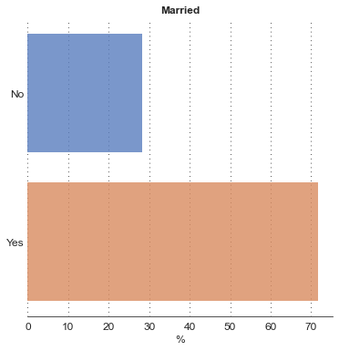
Our visitors are typically married and male.
While around 3 out of 4 visitors tend to be married, purpose of visits can range widely and these travellers have different needs.
Prompt: How can we make information more accessible to aid the planning for this group?
Charts
Breakdown of visitors by gender, reported in percentages
Breakdown of visitors by marital status¹, reported in percentages

Slide 6
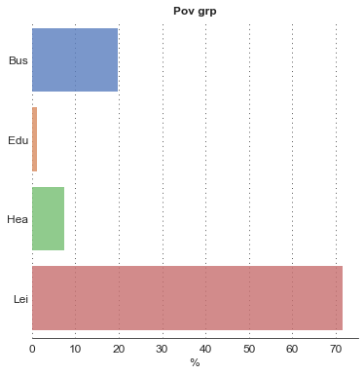
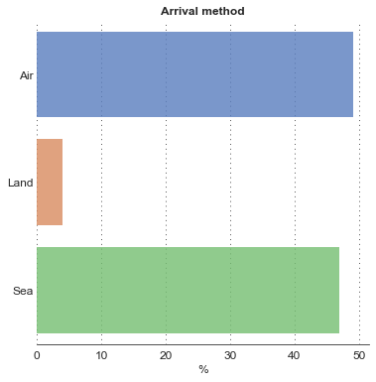
Leisure and business are the two main reasons for visiting Singapore. Sea and Air travel are both popular options.
Leisure and business remain the most popular reasons for visiting, comprising about 85% of the data.
Prompt: What are the demographic differences between Sea and Air travellers?
Charts
Breakdown of visitors by purpose of visit, reported in percentages
Breakdown of visitors by arrival method, reported in percentages

Slide 7
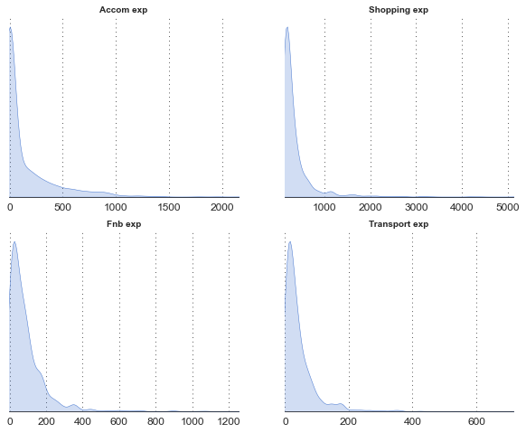
Most of these visitors spend within narrow ranges per expense category, with a few outliers.
Expenses all exhibit right skew, indicating the presence of high spending individuals. Distributions are unimodal and contain little spread, suggesting that a majority of visitors tend to spend similar amounts.
Prompt: What are the characteristics of high spending visitors?
High, narrow peaks with steep drop offs
Presence of long tails – high spenders
Charts (Clockwise from top left)
Kernel density estimate of the distribution of accommodation expenses, shopping expenses, food and beverage expenses, transport expenses

Slide 8
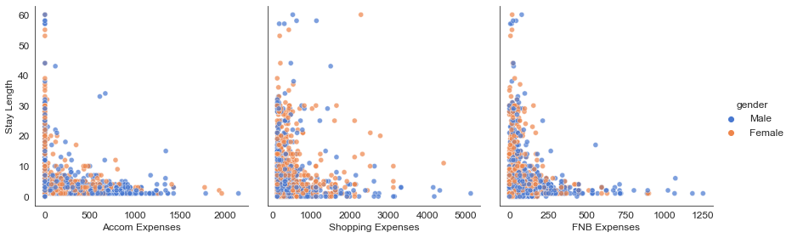
There is little association between stay length and general expenses. However, higher spenders tend to be male.
More males (blue) towards the higher end of the spending spectrum
More females (orange) towards the lower end of the spending spectrum
Charts
Scatterplot of Stay Length against Expenses, broken down into accommodation, shopping, and food and beverage expenses, segmented by gender

Slide 9
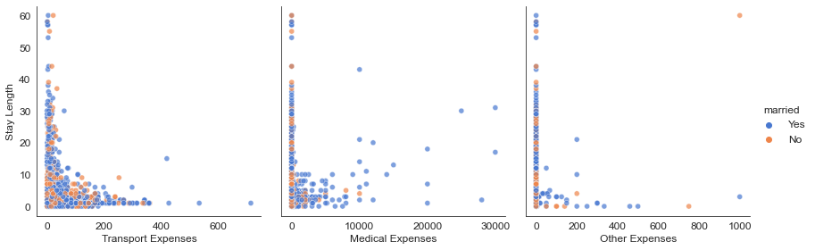
When it comes to medical expenses, higher spenders tend to be married – a reflection of an older and more affluent demographic.
High spenders tend to be married (blue) and spend high amounts
Charts
Scatterplot of Stay Length against Expenses, broken down into transport, medical, and other expenses, segmented by marital status

Slide 10
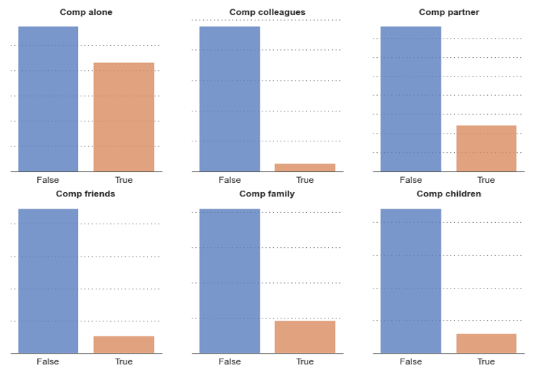
Most common group makeups include travelling alone, with a partner, with family (parents, siblings).
The common group makeups are reflective of groups here for leisure in Singapore. Notably, only a small percentage of visitors arrive with colleagues, suggesting that business travellers usually travel solo.
Prompt: How can we maintain attractiveness to solo businesspeople and young couples, while boosting attractiveness for parents?
Charts (Clockwise from top left)
Bar plots of common companion makeups: solo travelling; with colleagues or business partners; with spouses, partners; with friends; with siblings, parents, grandparents; with children

Slide 11

Recap of a typical visitor
Demographics
Gender | MALE
Age | 25 – 49
Travel Type | FIT
Arrival Method | AIR / SEA
Marital Status | MARRIED
Purpose of Visit | LEISURE / BUSINESS
Stay details
Stay Length | 2 DAYS
Total Spends ($) | $437
Avg Spends ($) | $237
F&B Spends ($) | $53
Transport Spends ($) | $25

Slide 12
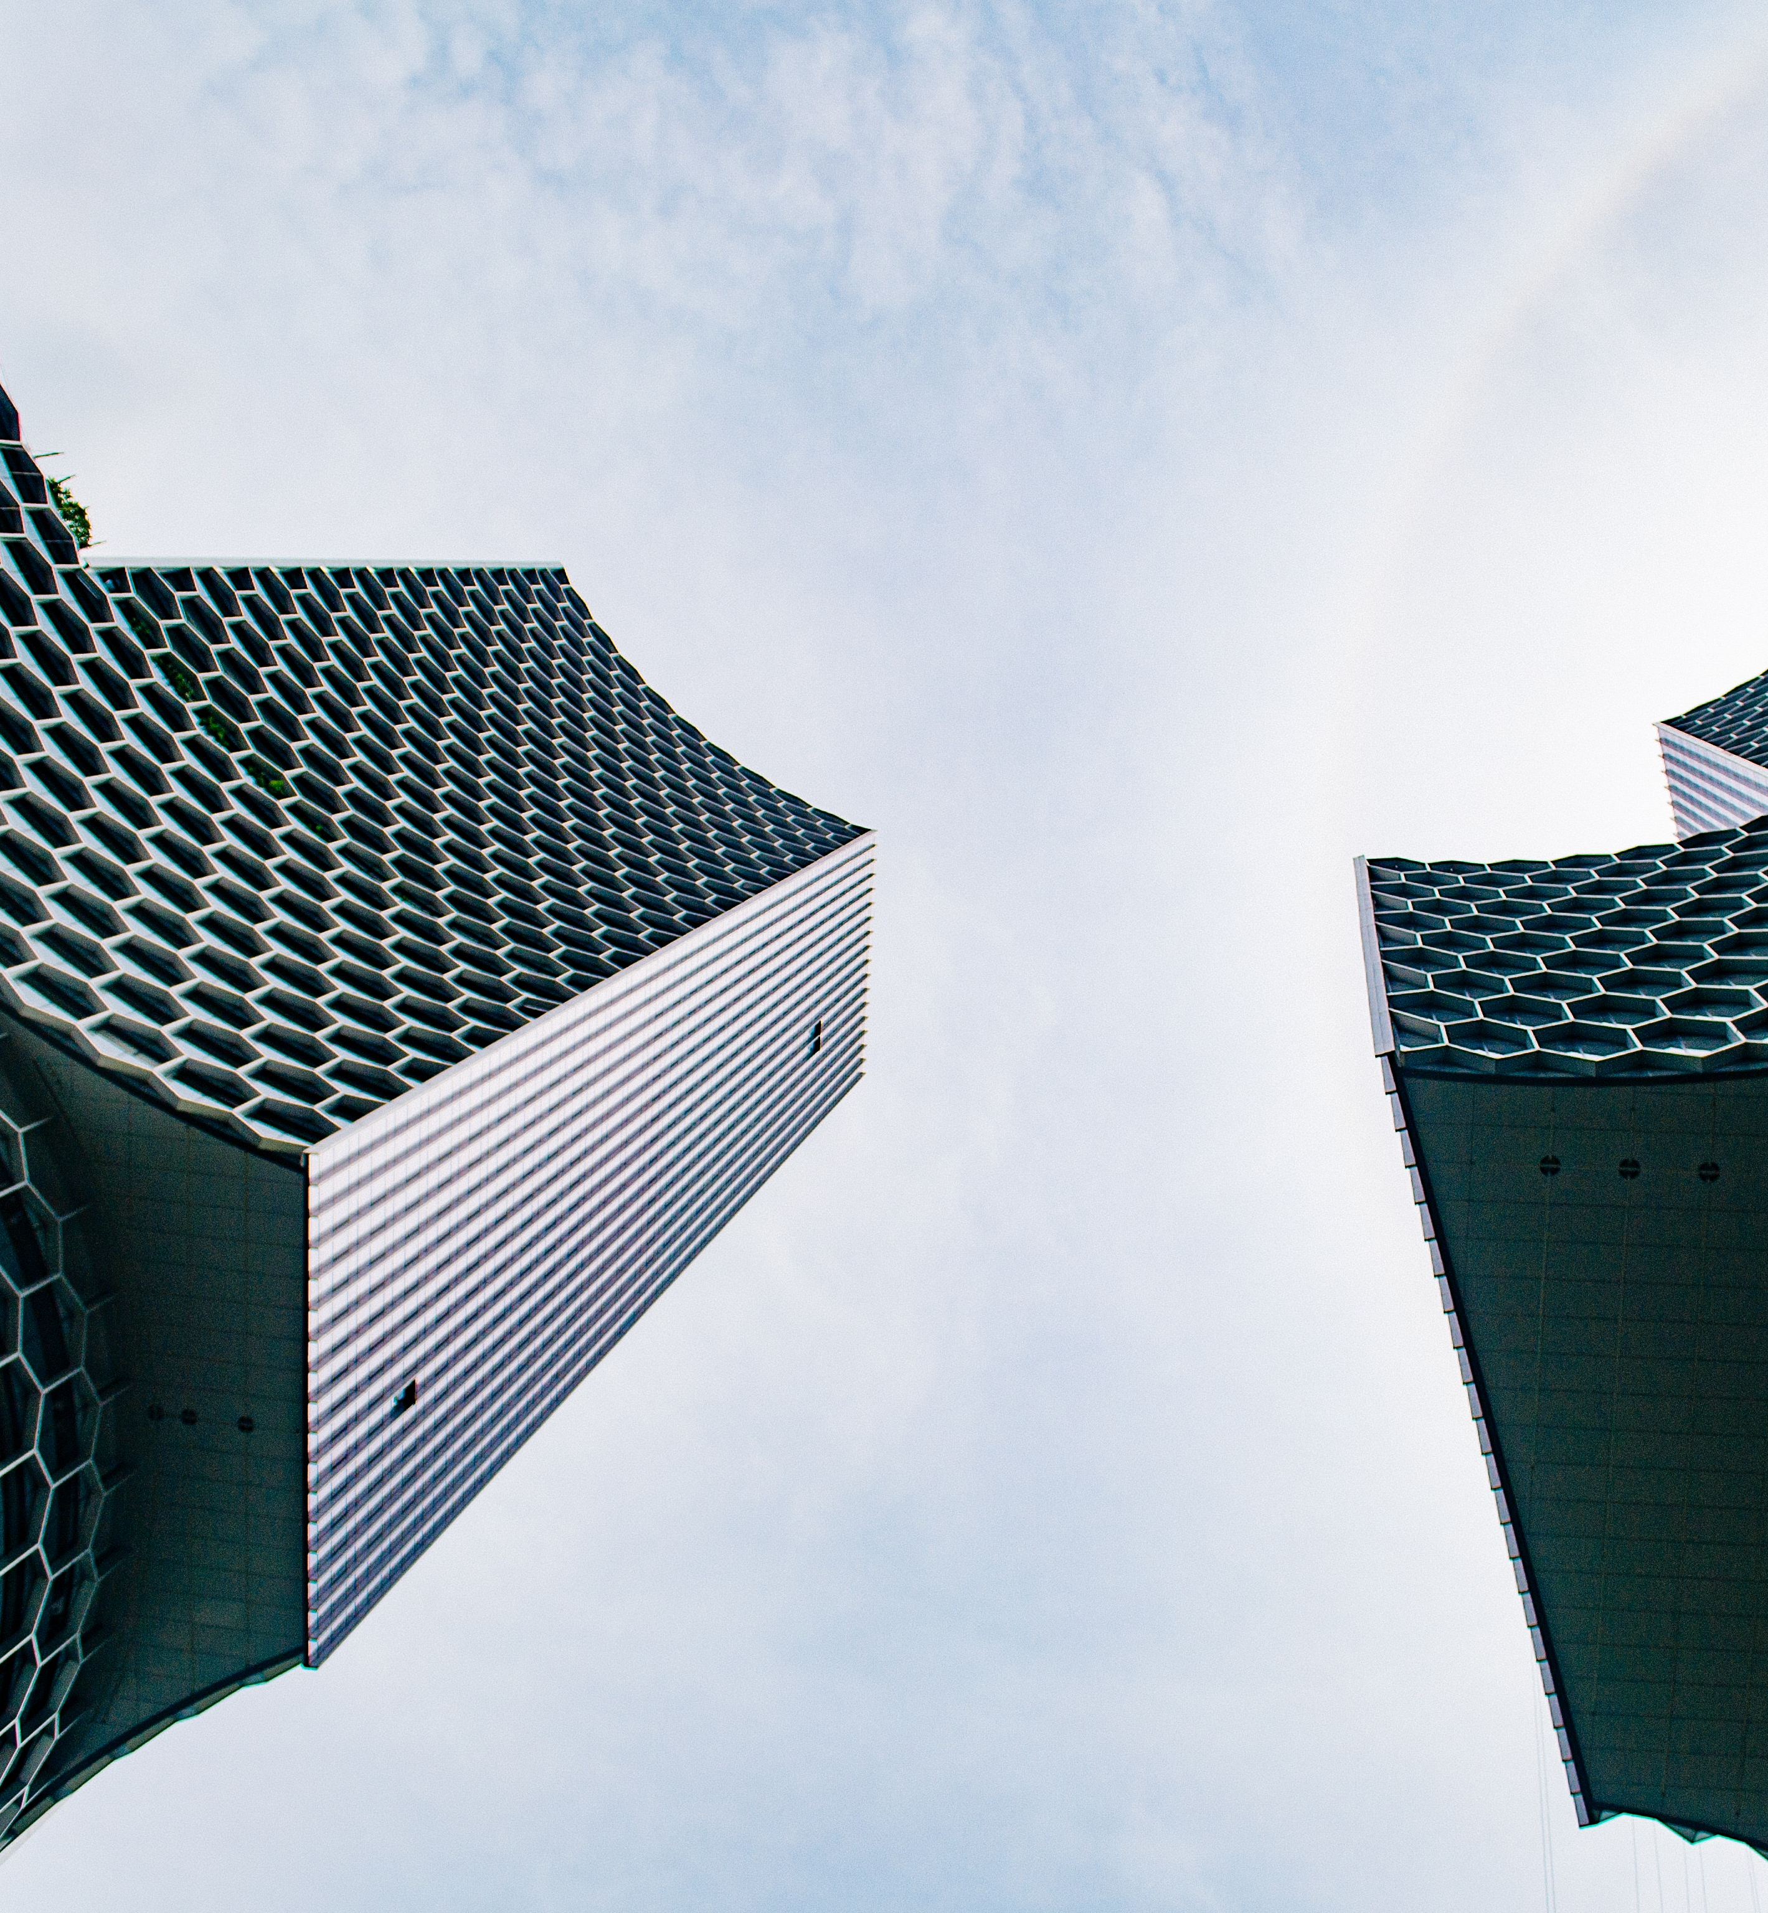
Correlations
Coverage
In-depth examination of relationships and associations among variables

Slide 13
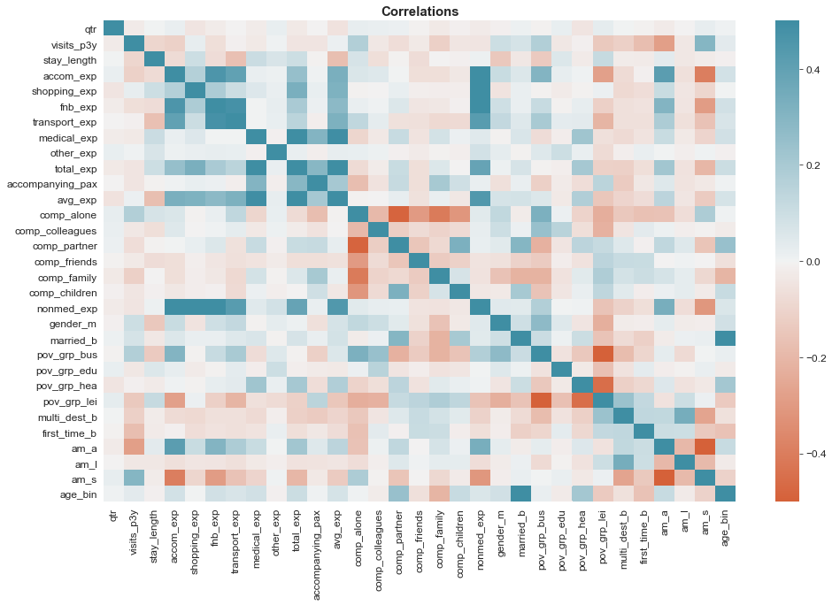
General Correlations
Notes
Little correlation between group makeup and spending – slight correlation with travelling with partner and medical expenses.
Males tend to be on business and less for leisure; reverse true for females.
Strong relationship between age, marital status and visiting for healthcare reasons.
Travellers by air tend to stay longer, spend more for leisure, and be less frequent visitors; vice versa for sea travellers.

Slide 14
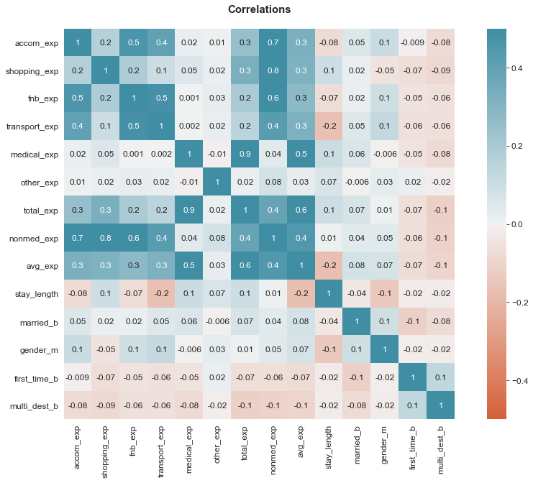
Expenses + Demographics
Notes
Generally good correlations amongst typical holiday activities, such as shopping, F&B, accommodation, and transport – suggesting that high spenders spend consistently across categories.
Lack of correlation between medical and other expenses suggest that travellers coming to Singapore for healthcare-related reasons do not typically spend much on other activities in Singapore.
Slight directionally positive relationships between marital status and expenses, and directionally negative relationships between first timers, multi destination travellers, and expenses.¹

Slide 15
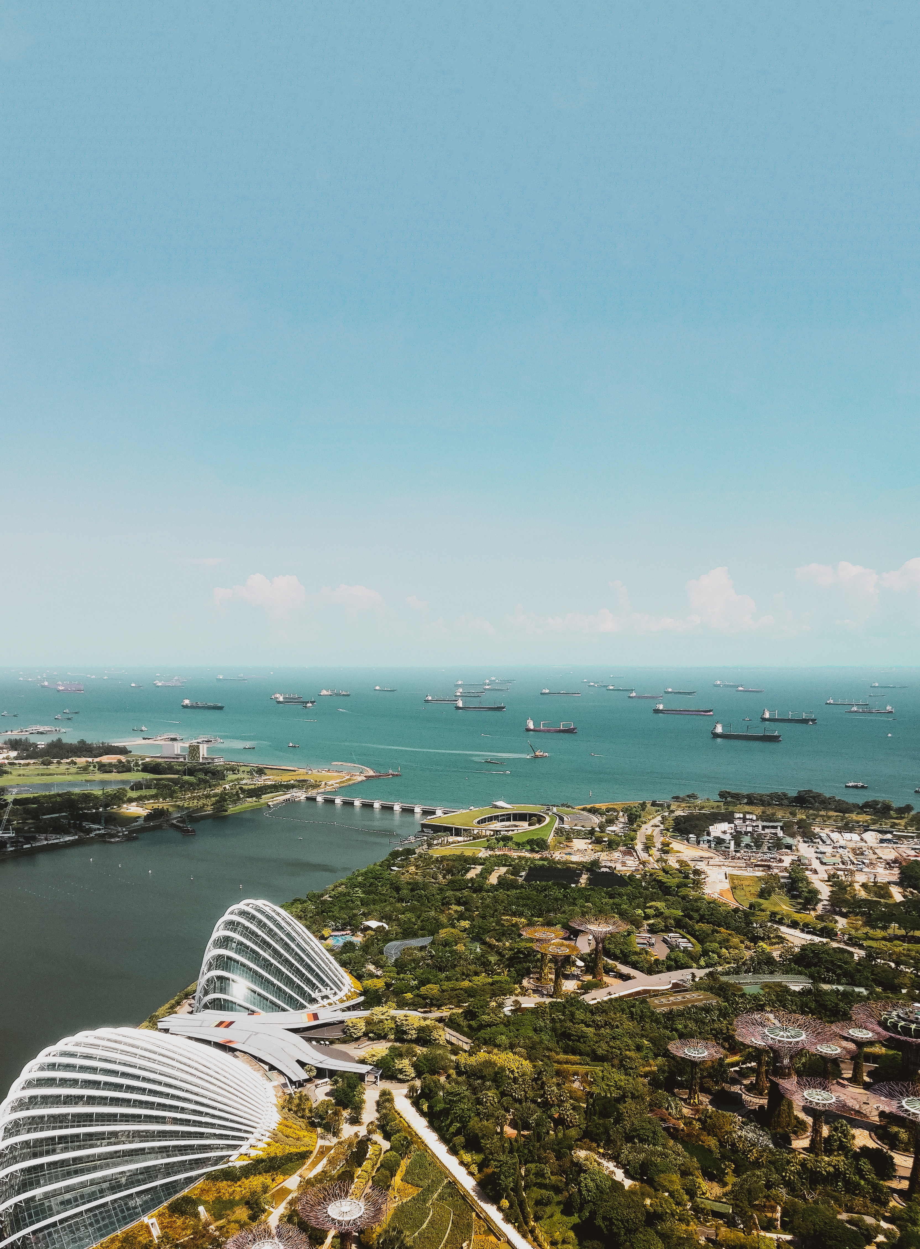
Differences Across Time
Coverage
How do our variables change through the months?
Can we detect any seasonal patterns or trends in our data?

Slide 16
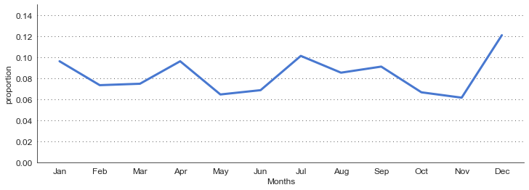
General peak months include January, April, July and December, while months with lulls include May and November
There might be a seasonal component in the amount of visitors observed (towards the end of the quarter). It would be also useful to find out the breakdown of purpose of visits for each month.
Prompt: What are potential reasons behind months with high traffic and vice versa?
Charts
Line plot of proportion of total visitors against month of visit

Slide 17
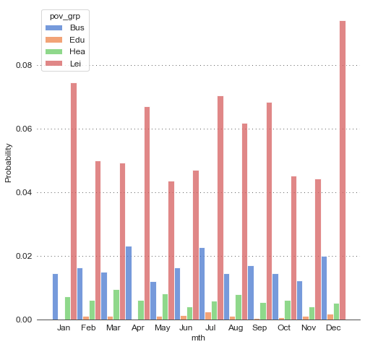
Peak months stem from the increases in visits for business and leisure, particularly July and December. April and July appear to be popular months for business travellers.
Spikes due to the increase in visitors for leisure are aligned with school holidays, months where annual leaves are typically cleared, and semester breaks. Months with higher amounts of traffic are typically followed by periods of lull.
Prompt: How can we design promotions to boost the lower traffic in off-cycle months?
Proportionately higher number of visitors for leisure purposes
Proportionately higher number of visitors for business purposes
Charts
Breakdown of purpose of visit group of visitors, by month of visit, normalized across purpose of visit groups

Slide 18
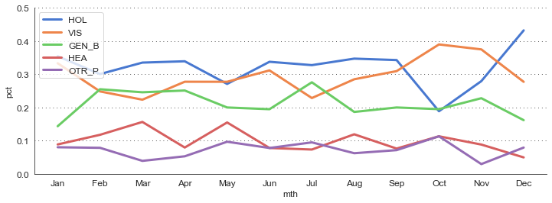
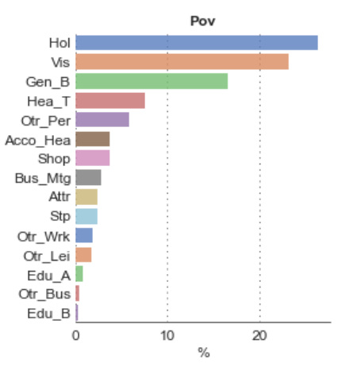
The top five most common reasons to visit include visiting friends and family, holidays, business, and healthcare.
Time-series analysis reveals different seasons for different purposes of travelling.
Prompt: How might we design marketing specifically to boost off-peak seasons?
Spike in holidays
Total proportion of purpose of visits
Lull in holidays, greater proportion of visiting during Oct and Nov
Charts
Line plots of the top five most common reasons to visit, by month of visit, normalized across reasons to visit

Slide 19
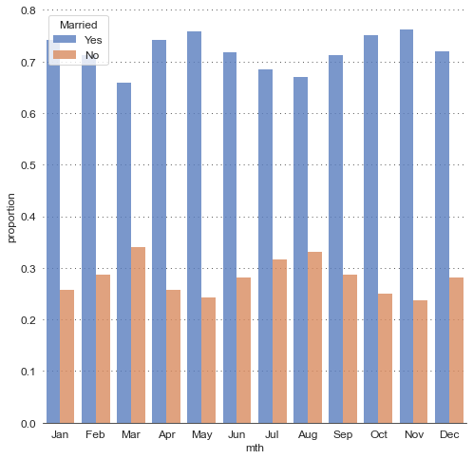
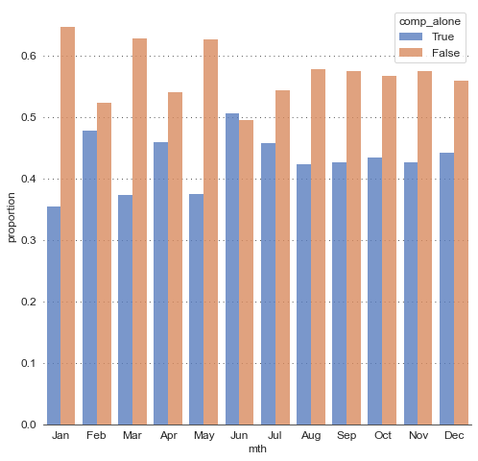
Different months cater to different demographics. Months with less traffic tend to attract non-married, solo travellers
While Apr and Jul have higher traffic, these tend to be solo business visitors rather than holiday-goers
Months such as Mar and Aug (non-peak) tend to be more popular for non-married visitors – possibly hoping to avoid the peak months
Lulls in Feb and Jun tend to be more popular for solo travellers
Charts
Breakdown of marital status and companionship (solo), by month of visit, normalized across months

Slide 20
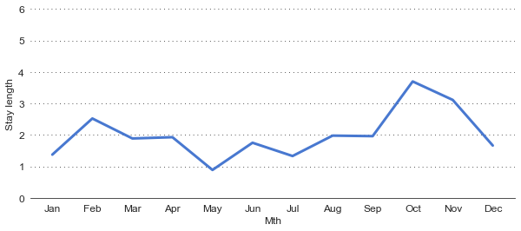
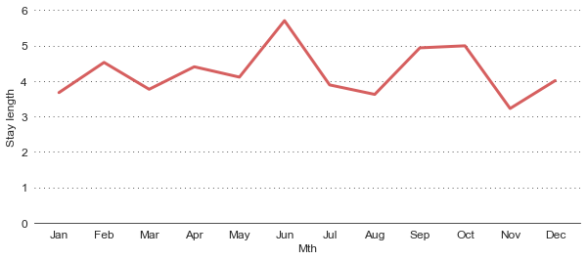
Business-related visits tend to be shorter than those for leisure.
There appears to be two kinds of leisure visitors – those whose visits are aligned with peak months and tend have a shorter stay, and those who visit friends / relatives during off peak months and stay longer. Business-related stays are the shortest during the most popular months – possibly periods where exhibitions and trade shows typically occur.
Apr and Jul, which are popular for business related travel, have short travel stays
Off-peak leisure visitors tend to spend a longer time in Singapore (these are often visiting friends and relatives)
Charts
Line plot of average stay amongst business visitors and leisure visitors, by month of visit
Travelling for business
Travelling for leisure

Slide 21
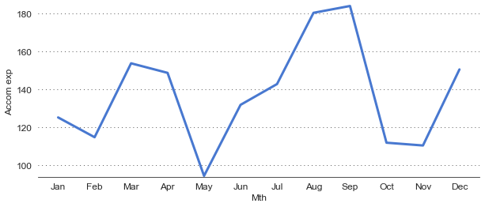
Fluctuations in average accommodation expenses might be reflective of hotel pricing variations – there seems to be little relationship between stay length and amount spent on accommodation.
Possible reasons for this observed phenomenon: visitors during off-peak periods tend to be younger, solo, and multi destination travellers. These visitors might be staying in cheaper hostels or staying over at friends or relatives’. During the off-cycle, hotel prices might also be cheaper on average.
Prompt: How might we design promotional activities specifically to boost off-peak seasonal activities by working with budget hotels / hostels?
Apr and Jul, which are popular for business related travel, have moderate accommodation expenses
May, Jun, Oct, Nov (months with higher proportion of “visiting friends / relatives” as pov, have low average accommodation spends
Charts
Line plot of average accommodation expenses amongst visitors, by month of visit, y-axis range narrowed to show variation more clearly

Slide 22
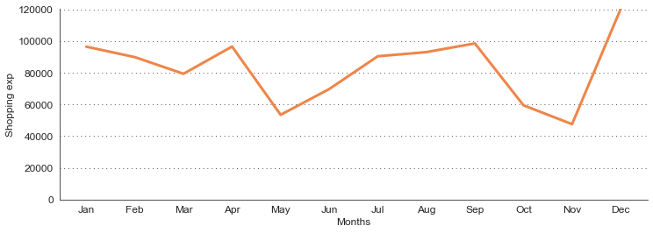
Months popular for leisure / holiday based visiting tend to have more spends in shopping
Months that are popular for visiting friends and relative (May, Oct, and Nov) have low total shopping spends. Possible reasons include seasonal variations (promotional periods) and the tendency for these groups of visitors to spend less on shopping.
Prompt: How might we design promotional activities specifically to boost off-peak shopping activities by working with relevant stakeholders?
Jan, Apr, Jul, Dec, popular months for leisure and holiday, have higher total spends in shopping
Charts
Breakdown of total shopping expenses amongst visitors, by month of visit

Slide 23
Recap of differences throughout the year
From identifying the common characteristics of visitors by each month, how can we design promotional materials and flight our campaigns so that the messaging is relevant to these demographics and interest groups?
JAN | FEB | MAR | APR | MAY | JUN | JUL | AUG | SEP | OCT | NOV | DEC
 | solo |  |  | short stay |  |  |  |  | visiting | visiting
 |  | unmarried |  | female | solo |  | unmarried |  |  | married
 |  |  | solo | married |  | solo | female | holiday
 |  |  | male |  |  | male |  |  |  |  | female
 |  |  | short stay |  |  | short stay |  |  |  |  | holiday
Education
Healthcare
Leisure

Slide 24
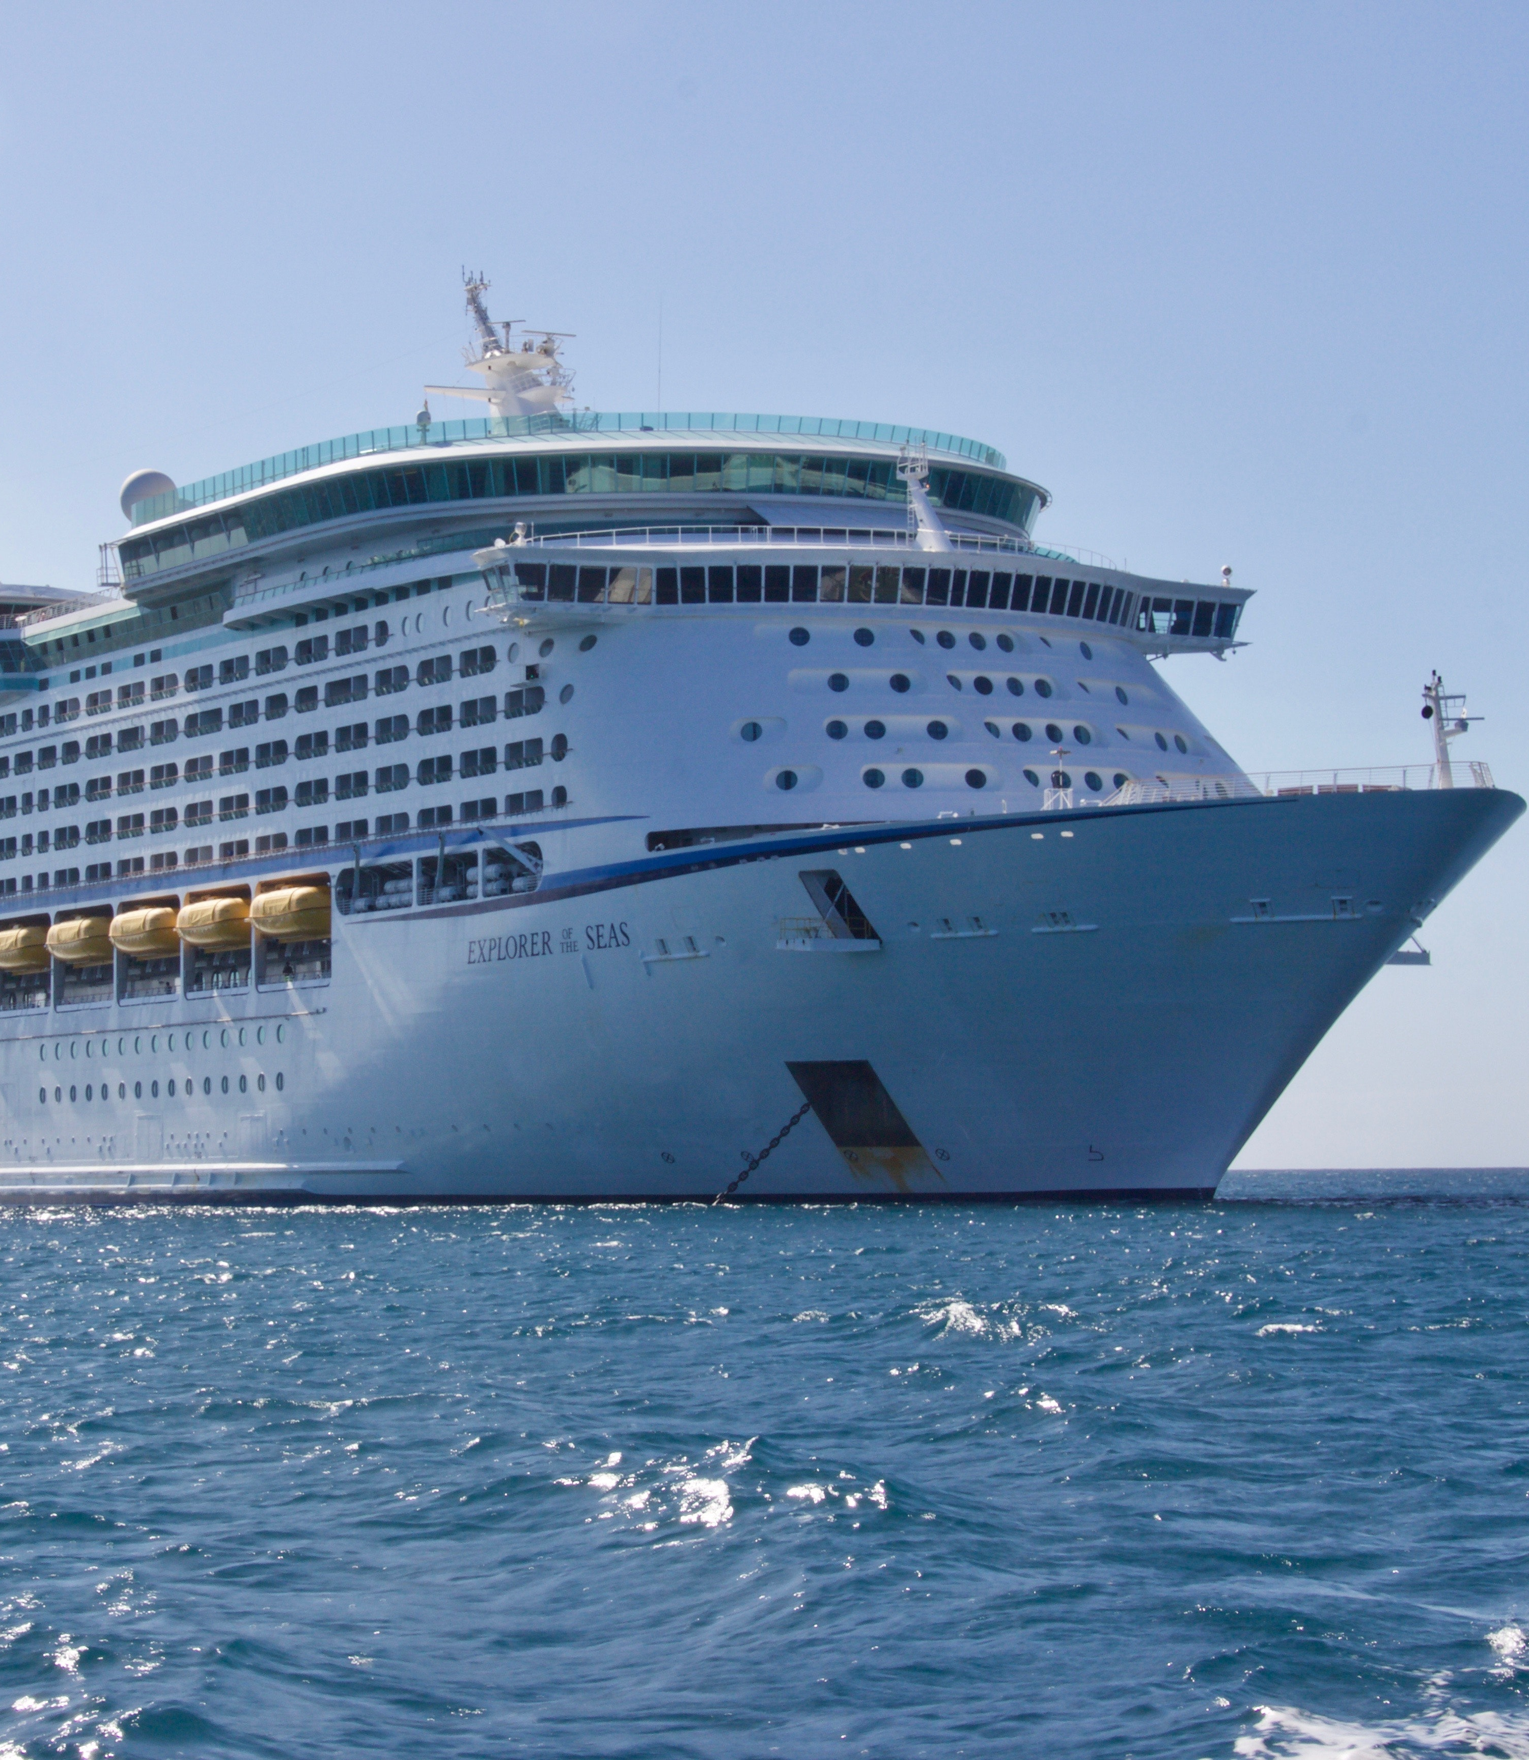
Purpose of Visit – Indepth
Coverage
Examining group differences between visitors with different POVs
Particularly, understanding the key differences amongst business and leisure visitors

Slide 25
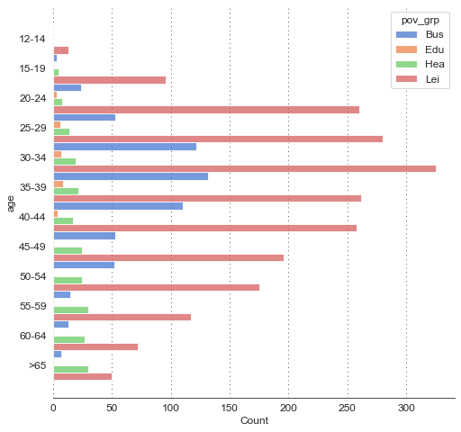
Business travellers are typically 30-54 years old, while travellers for healthcare related purposes tend to increase with age.
As business-related agendas include attending trade shows and exhibitions, these visitors are typically mid to late-career working professionals.
Visitors for educational purposes (company training, school trips, workshops / seminars) tend to be on the younger side.
Leisure visitors approximate the distribution of age groups, suggesting that there are a wide range of different demographics that visit Singapore for leisure.
Charts
Breakdown of purpose of visit – grouped by age

Slide 26
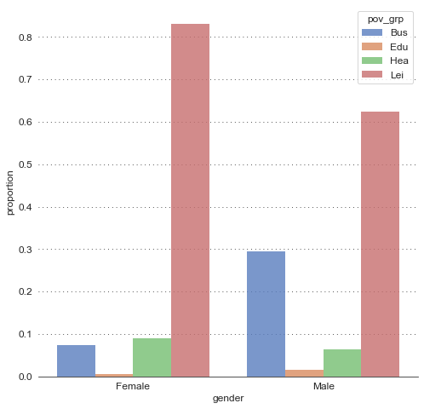
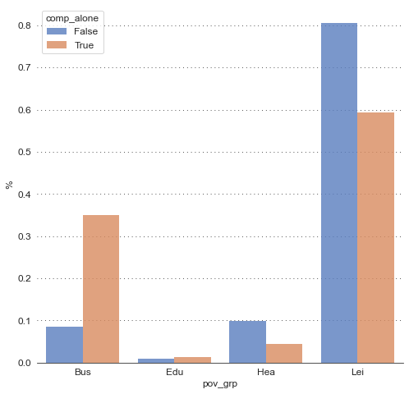
Visitors for business-related purposes are ~3x more times likely to be male, and ~3x more likely to be solo travellers.
Charts
Bar plot of proportion of gender, broken down by purpose of visit group
Breakdown of purpose of visit groups, grouped by solo / not solo traveller

Slide 27
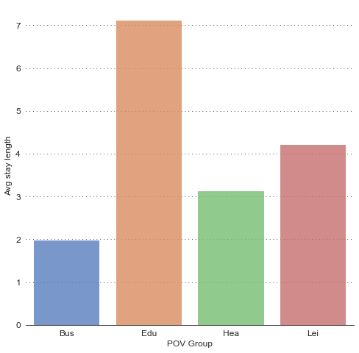
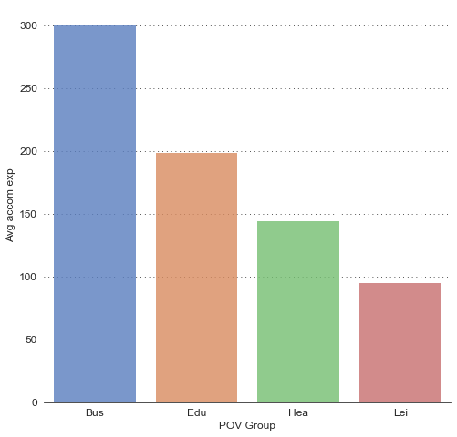
Amongst all visitors, business travellers tend to stay the shortest, but spend the most on accommodation and F&B.
~2 day stay length for business travellers, vs. ~4 day stay length for leisure visitors
Despite shorter stay length, business travellers tend to spend more on accomodation
Charts
Average stay length of visit, broken down by purpose of visit group
Average accommodation expenses, broken down by purpose of visit group

Slide 28
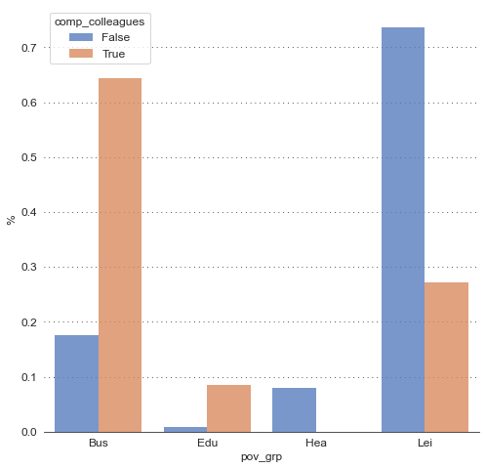
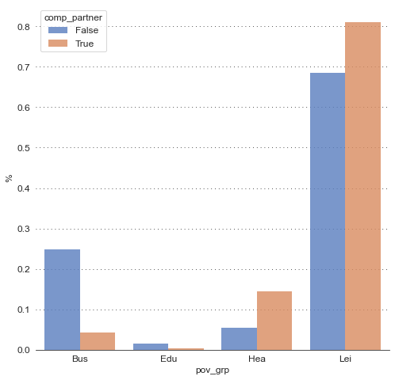
Visitors on business-related trips tend to be travelling with colleagues, while those with partners tend to be visiting for healthcare or leisure reasons.
Charts
Breakdown of purpose of visit groups, grouped by companion – colleagues
Breakdown of purpose of visit groups, grouped by companion – partners

Slide 29
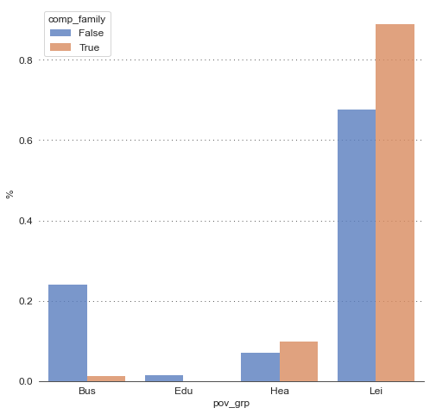
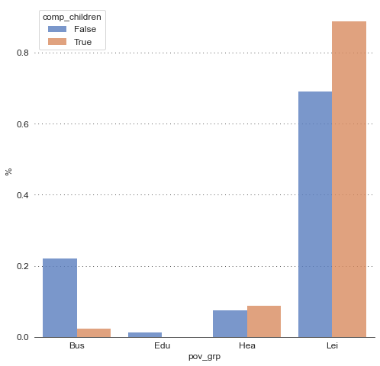
Business travellers are unlikely to travel with family or children, whereas the opposite is true for leisure travellers.
Charts
Breakdown of purpose of visit groups, grouped by companion – family
Breakdown of purpose of visit groups, grouped by companion – children

Slide 30
Recap of differences amongst purpose of visit groups
 | Business | Education | Healthcare | Leisure
Stay | ~2 days | ~7 days | ~3 days | ~4 days
Gender | Typically male | - | - | Typically female
Age | 30-54 | 20-44 | > 45 | -
Alone | Yes | - | No | No
With colleagues | Yes | Yes | No | No
With partners | No | No | Yes | -
With family | No | No | - | Yes
With children | No | No | - | Yes
Accommodation Spend | Highest | - | - | Lowest
F&B Spend | Highest | - | - | Lowest

Slide 31

Non-Medical Expenses
– Indepth
Coverage
Examining subgroups of visitors using non-medical expenses
Who do our highest-value spends tend to be?

Slide 32
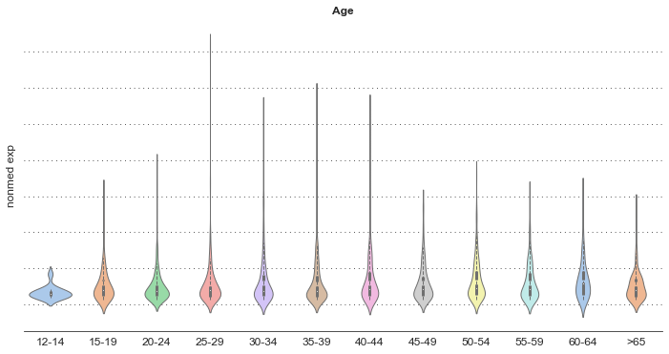
Non-medical spends¹ consistently increase with age, up till 65, where they revert back to lesser amounts.
Presence of long tails indicate high spending outliers within the age group, but younger age groups tend to have fatter bottoms (more densely clustered around lower spends)
Distributions start to shift up as age increases, indicating that older visitors are likely to spend more
Bottoms appear less heavy
Most common spends appear low
Charts
Violin plot of non-medical expenses, by age

Slide 33
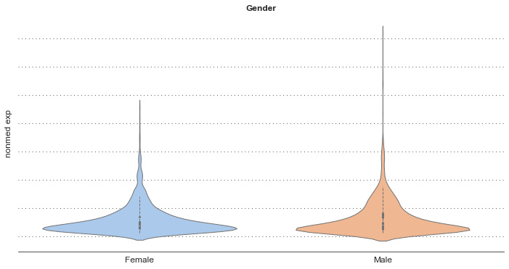
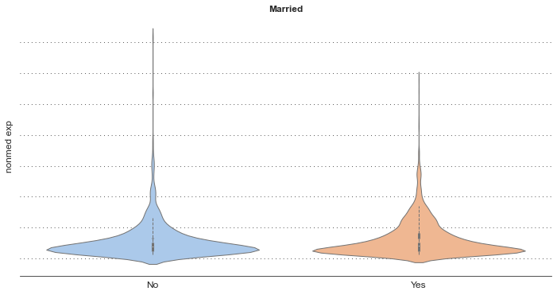
High-spending outliers tend to be male and unmarried, but married visitors consistently spend more.
One possible reason for higher spends for married visitors: paying for food, shopping and accommodation for young children.¹
Male visitors also appear to have fatter tail ends – indicates that male visitors tend to spend more
Married visitors have slightly thicker tails, indicating greater propensity to spend more
Charts
Violin plot of non-medical expenses, by gender and marital status

Slide 34
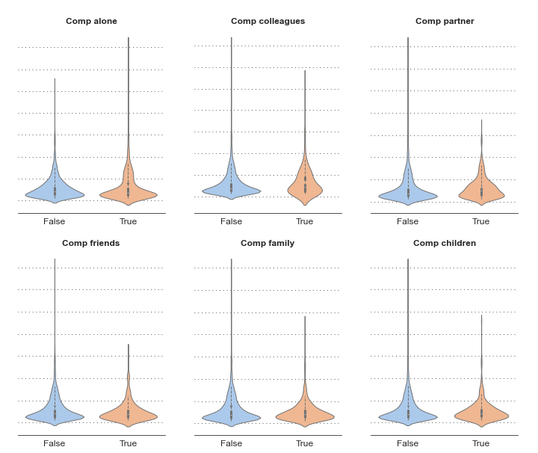
Non-medical spends differ across the companionship group makeups – highest spenders tend to be business visitors w/ colleagues or couples.
Notes
Visitors with friends, family tend to spend less – possibly due to saving on accommodation / F&B when visiting friends.
Visitors with colleagues tend to spend more – possible expenses include entertaining, transport for travelling around Singapore.
Solo travellers tend to spend more – likely as they tend to spend more time in Singapore.
Visitors with partners tend to spend more – possibly due to honeymoon / vacation effects leading to more spending on shopping / F&B.
Charts
Violin plot of non-medical expenses, by travel companions

Slide 35
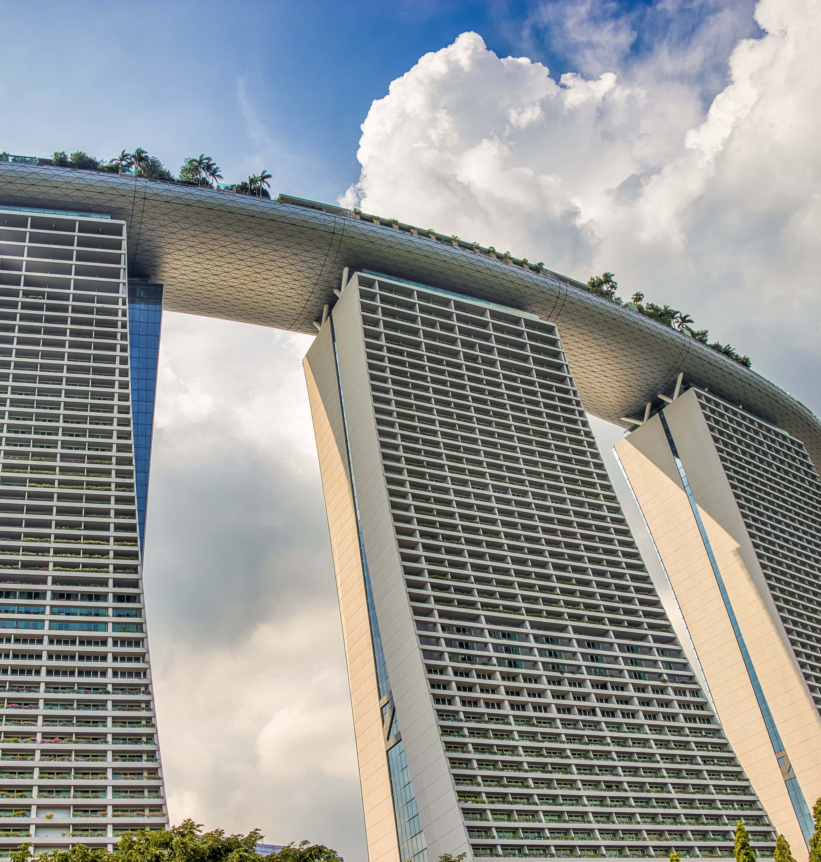
Stay Length
– Indepth
Coverage
Examining subgroups of visitors using stay length
Can we detect any patterns or trends in our data?

Slide 36
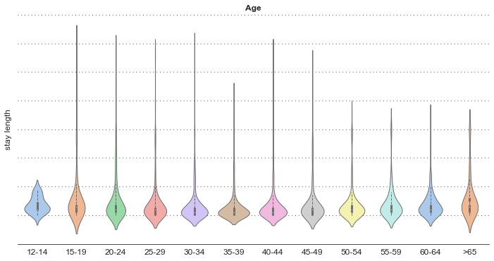
Stay lengths tends to get shorter and less variable in the middle of age demographics.
Spread out distributions indicate large variability in stay lengths
Spread out distributions indicate large variability in stay lengths
Heavier bottoms
Charts
Violin plot of stay length, by age

Slide 37
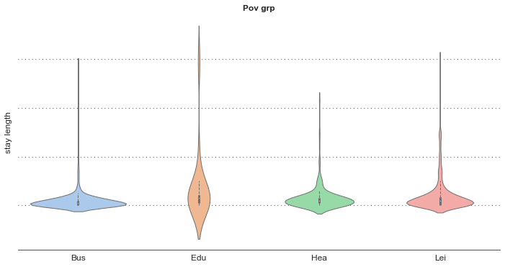
Business visitors tend to stay the shortest, while education-related visitors tend to stay the longest.
These trends are indicative of the length of activities that these travellers visit Singapore for; trade shows, meetings, exhibitions appear to take less time, while school trips, company trainings, and holiday camps tend to span more days.
Charts
Violin plot of stay length, by purpose of visit group

Slide 38
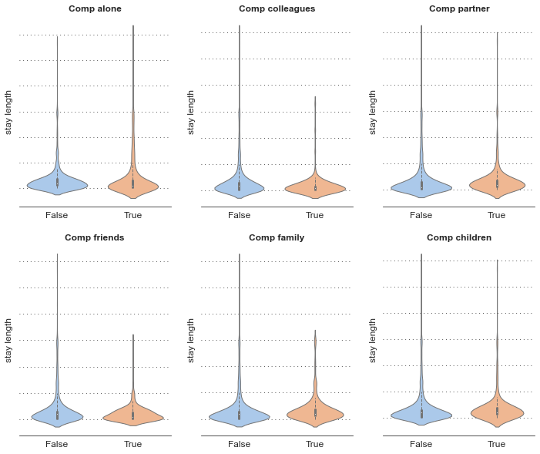
Stay Length across companion groups appear to underscore purpose of visits.
Notes
Solo travellers were more likely to spend more time in Singapore, possibly boosted by off-peak travellers, visitors on educational-related purposes.
Family trips and trips with children tend to be longer – possibly reflective of slightly longer stay lengths for leisure purposes.
Trips with colleagues tend to be shorter – underscoring the shorter stay lengths for business trips.
Charts
Violin plot of stay length, by travel companion

Slide 39
Characteristics of individuals who stay longer / spend more
 | Non-Medical Spends | Stay Length
Age | Tends to increase with age up till 65 | Longer for younger and older quartile
Gender | Higher when male | Higher when female
POV | Highest with business | Highest with education
Marital Status | Higher when married | -
Alone | Higher when alone | Higher when alone
With colleagues | Higher w/ colleagues | Lower w/ colleagues
With partners | Higher w/ partner | Higher w/ partner
With family | Lower w/ family | Higher w/ family
With children | - | Higher w/ children
With friends | Lower w/ friends | Lower w/ friends

Slide 40
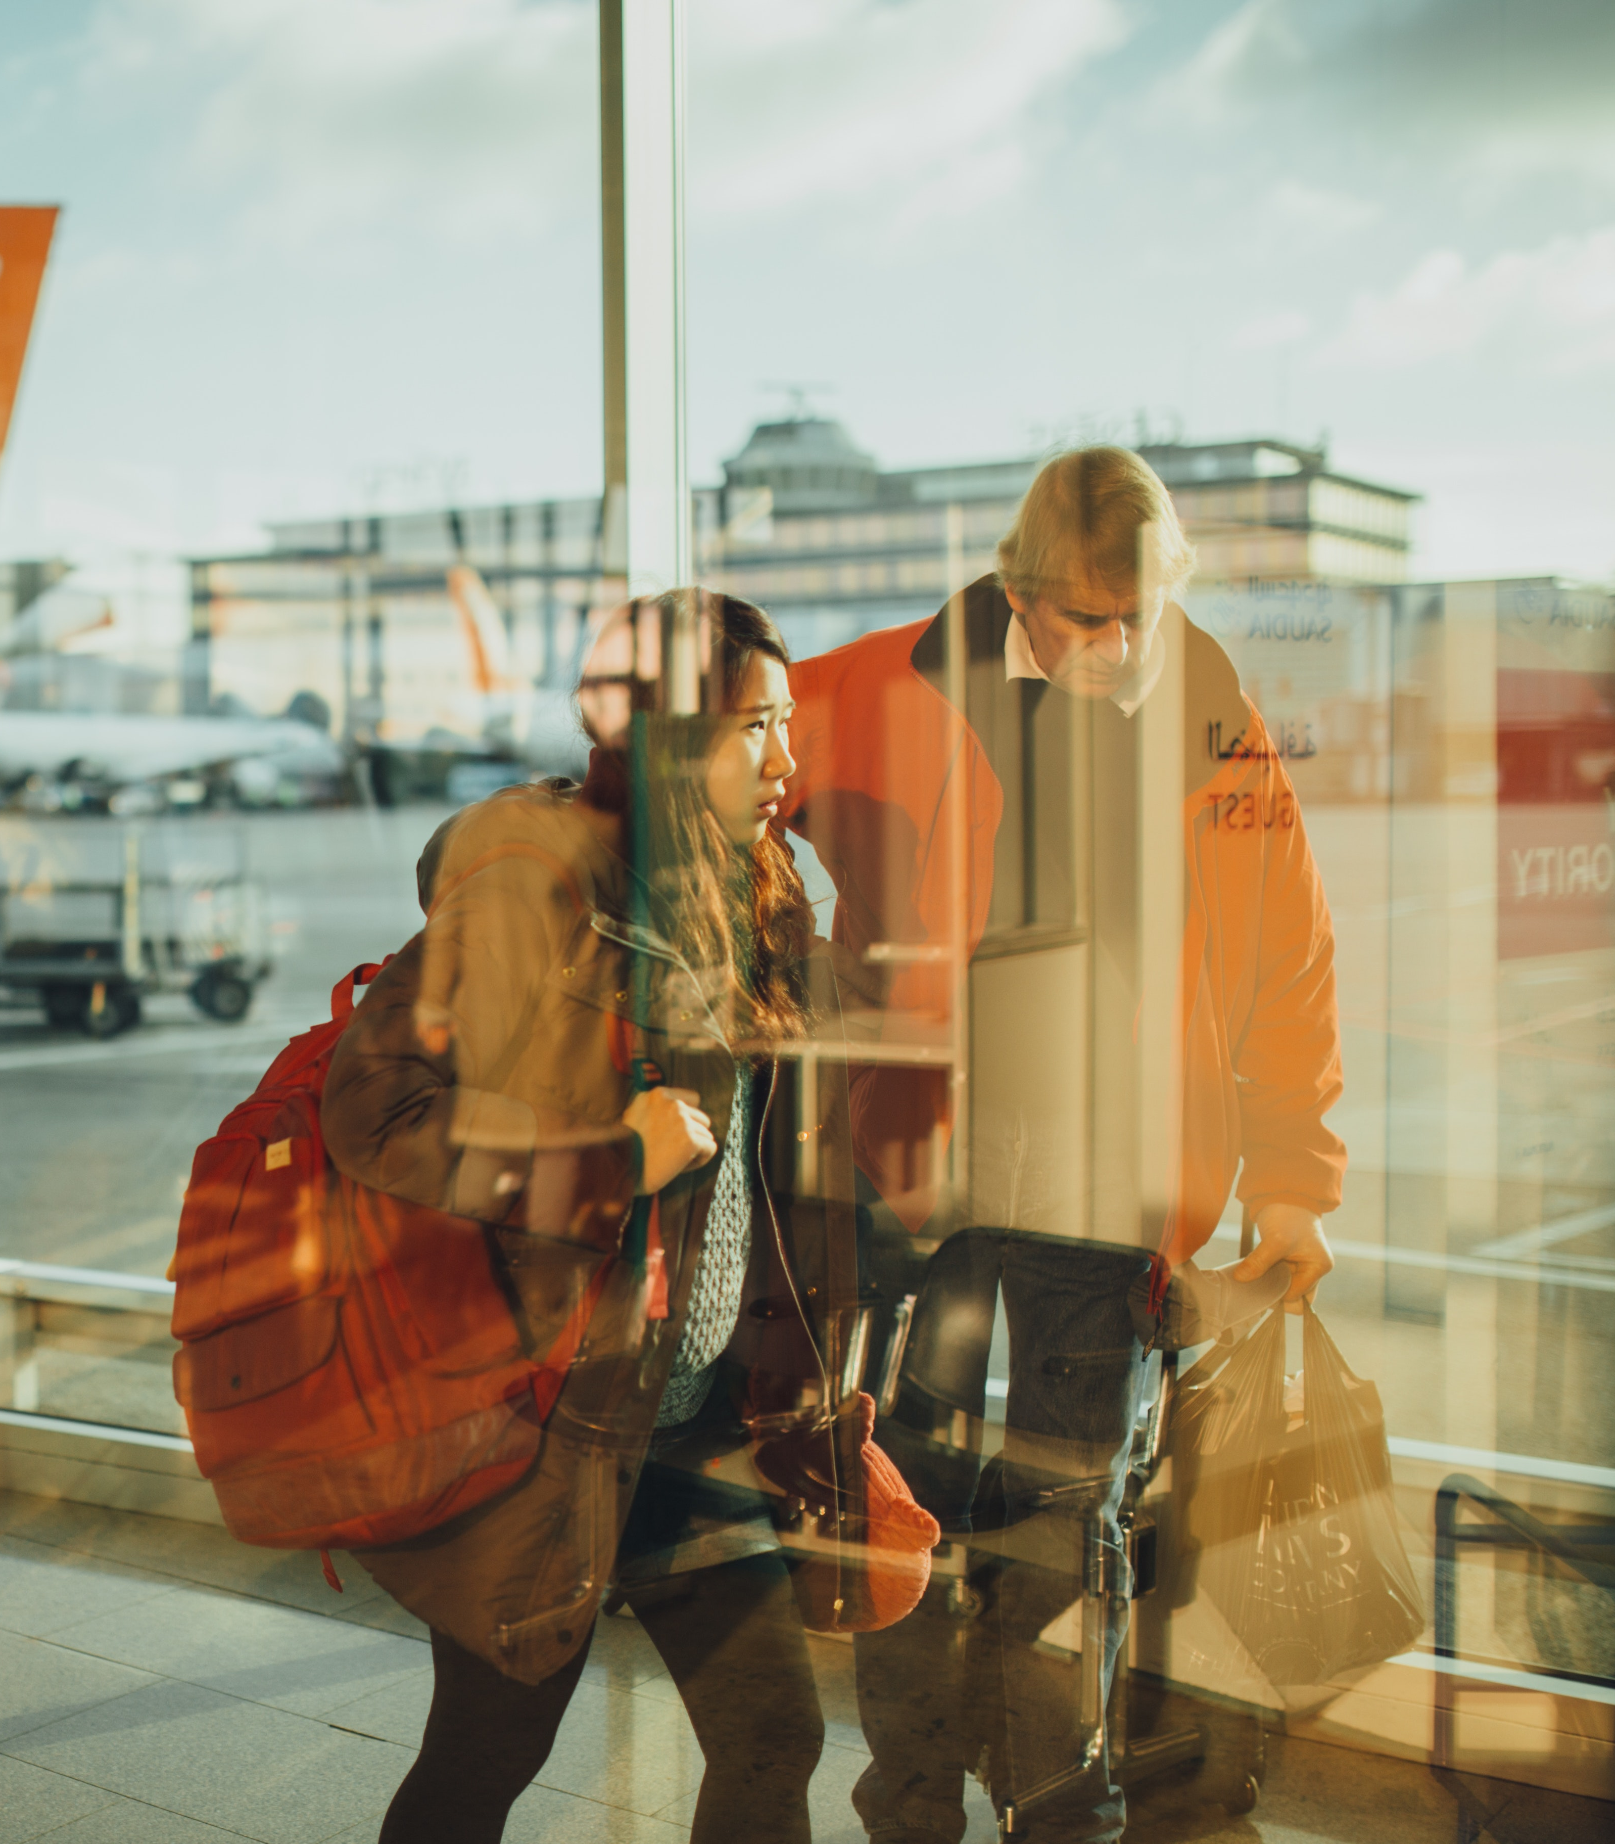
Potential Next Step
Unsupervised Clustering to identify latent groupings within dataset
Possible techniques: K-means, SMOTE, or percentile scoring can be used to identify less obvious groups of visitors within the data to better target these customers.

Slide 41
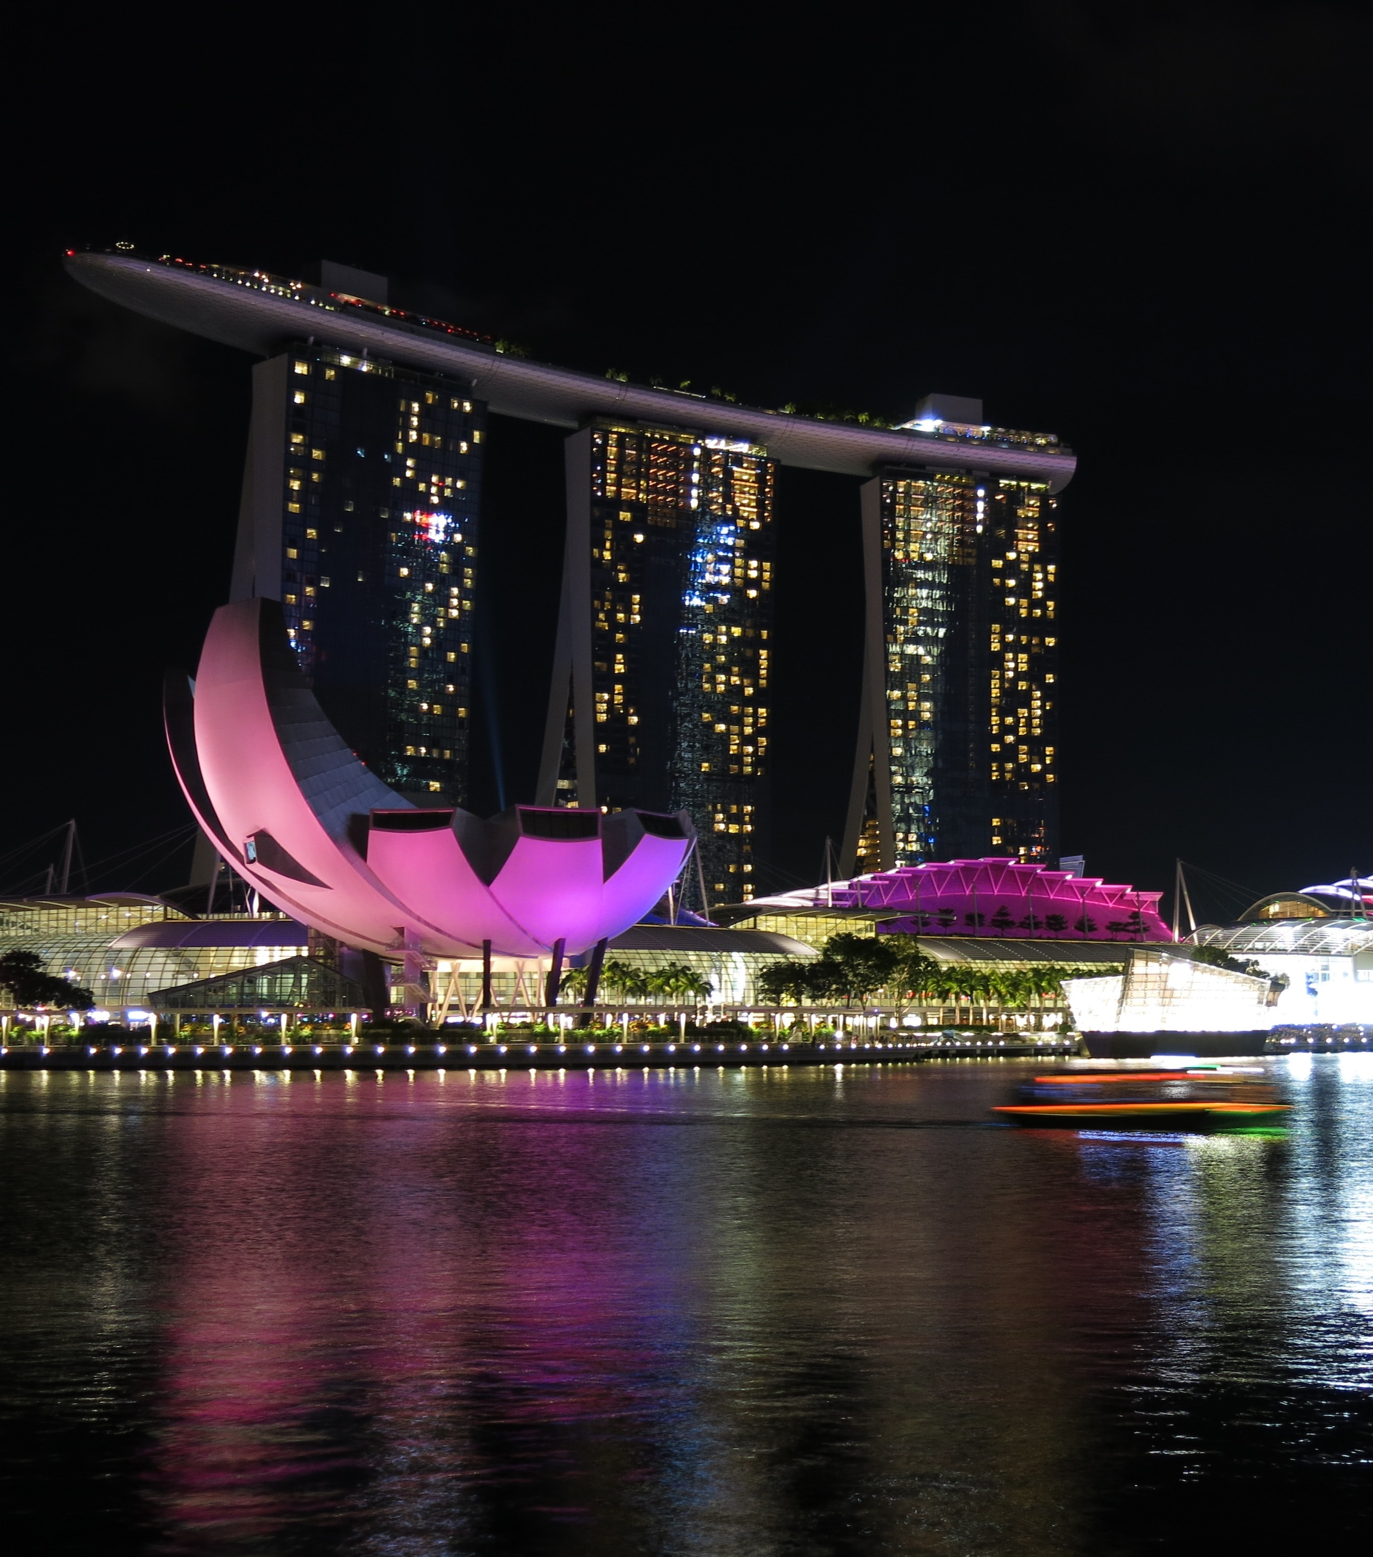
Potential Next Step
Dimensionality reduction for better profiling
Possible techniques: Principal Components Analysis can be used to create factor groups which helps to identify essential dimensions that captures our visitors more succinctly.

Slide 42
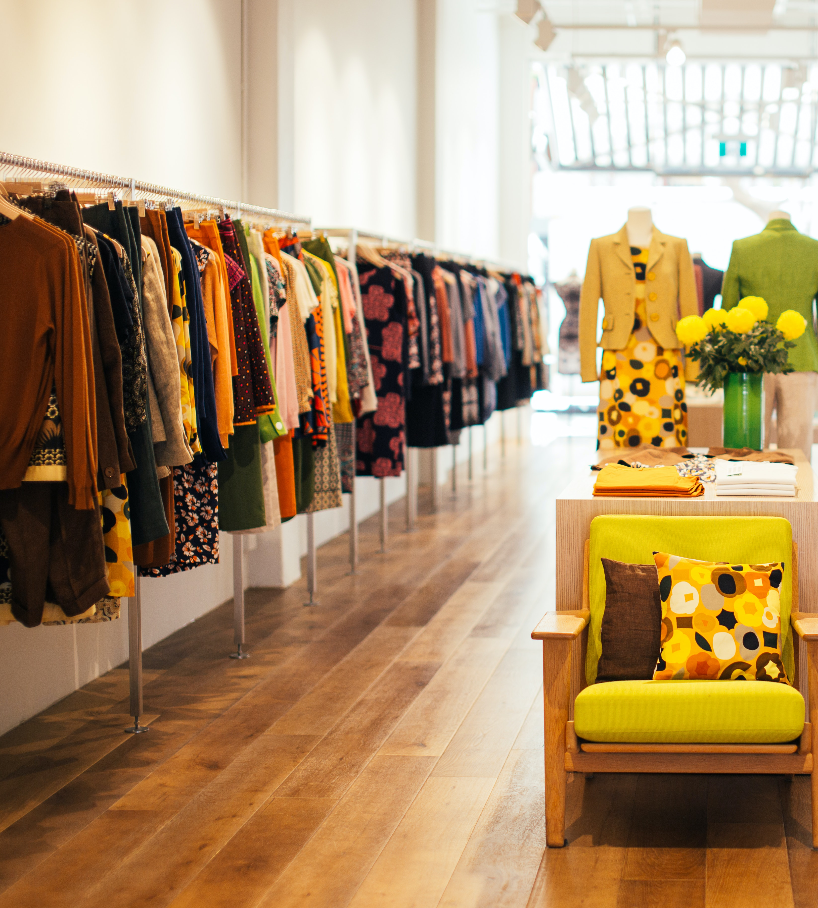
Potential Next Step
Regress Non-Medical Spends against variables to quantify relationships
Possible techniques: Linear Regression (potentially w/ regularization) or Tree-based models can be used to understand exactly how each variable is associated with non-medical spending.

Slide 43
Thank you
Clarence San

